Slide 1

APPLICATION SECURITY
(Threats and Malpractices)
Speaker: Dimitrios Valsamaras | @Ch0pin
https://www.linkedin.com/in/valsamaras/

Slide 2

Common Malpractices
Webviews
Floating Windows
Accessibility Service
Administration API
Reflection
Dynamic Code Loading

Slide 3

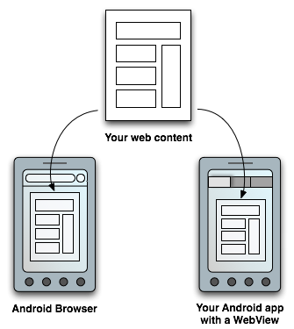
Webviews
Usage: WebView objects allow the developers to deliver web-based content to the user as a part of an activity’s layout.
Customization
Increased control over the UI

Slide 4
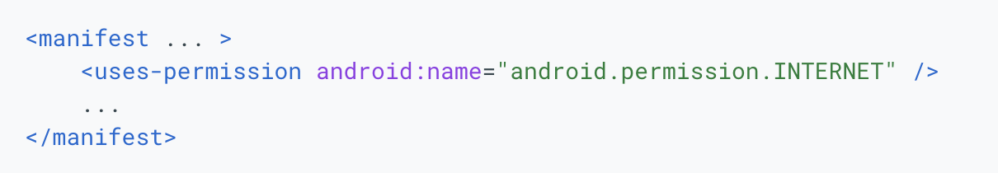
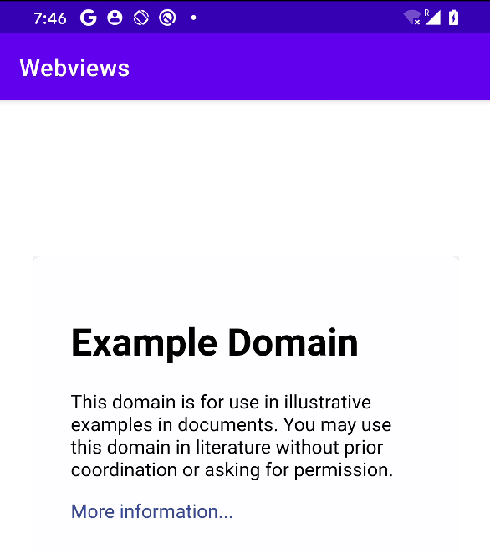
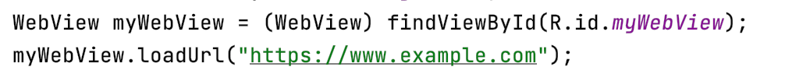
Webviews - Basic Usage

Slide 5
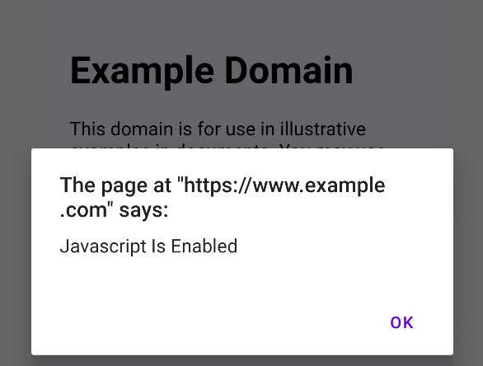
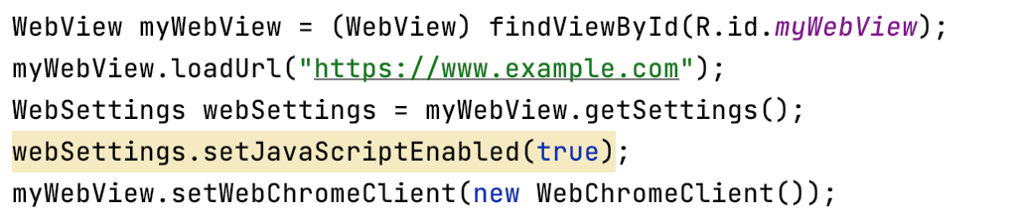
Webviews - Enabling Javascript

Slide 6
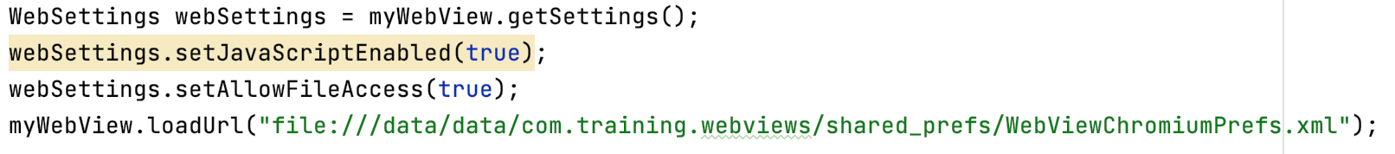

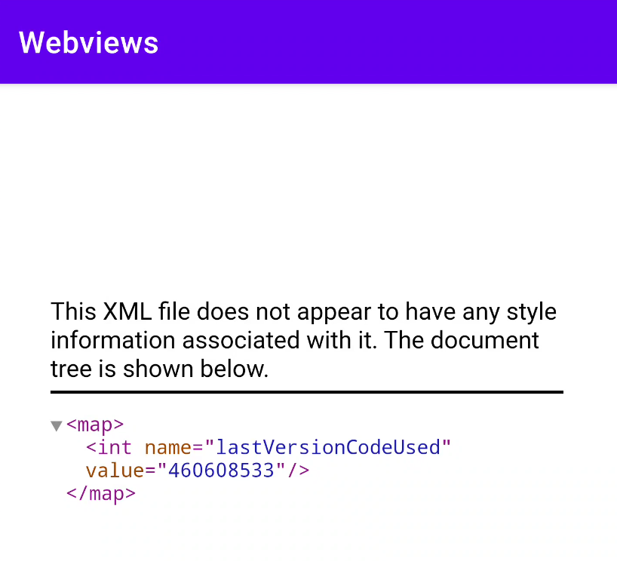
Webviews - Enabling File Access
? ?

Slide 7
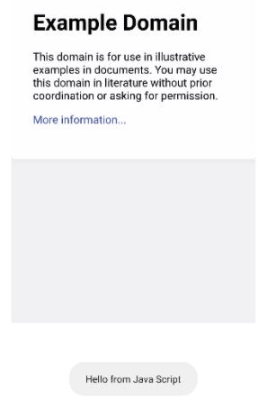
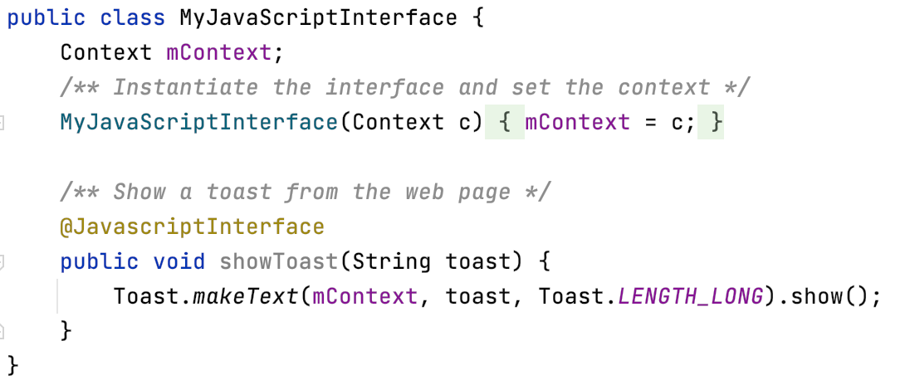
Webviews - Bridging Java with Javascript
Javascript:
function showAndroidToast(toast) {
AndroidBridge.showToast(“Hello from Java Script”);
}

Slide 8
Webviews - Malpractices
Intentional

Slide 9

Webviews - Malpractices
When misused WebViews impose a great risk for the user !!
Common Malpractices:
Javascript Injection
Web Scraping
Backdoor-ing
Silent Loading

Slide 10
WebViews - Javascript Injection
Using the onPageStarted, onPageFinished callbacks or the onProgessChanged (less common) we may track the loading process of a web page and append arbitrary code.
myWebView.setWebViewClient(new WebViewClient() {
@Override
public void onPageFinished(WebView view, String url) {
super.onPageFinished(view, url);
INJECTION POINT
}
});

Slide 11
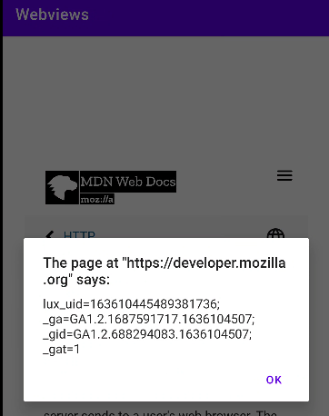
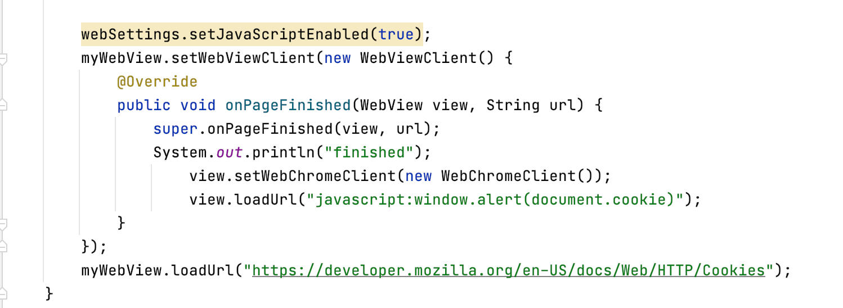
WebView - Javascript Injection - Cookies

Slide 12
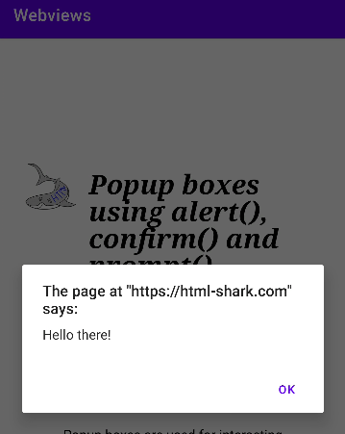
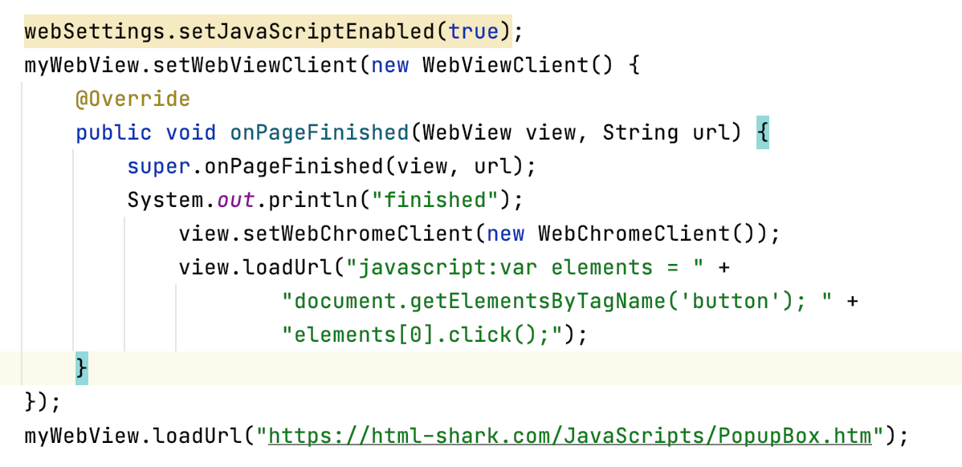
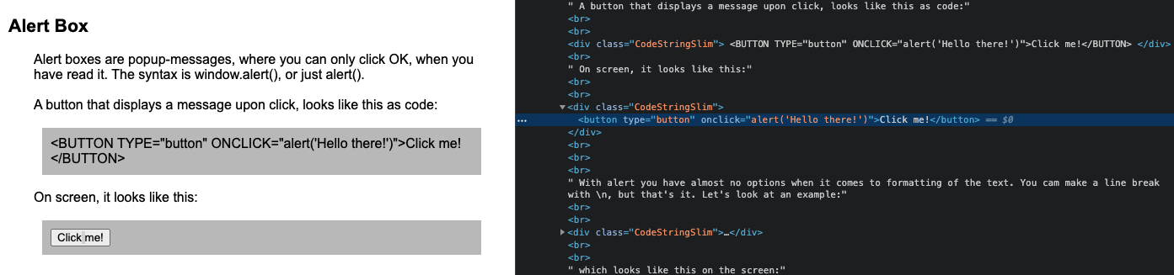
WebViews - Javascript Injection - Auto Clicks

Slide 13
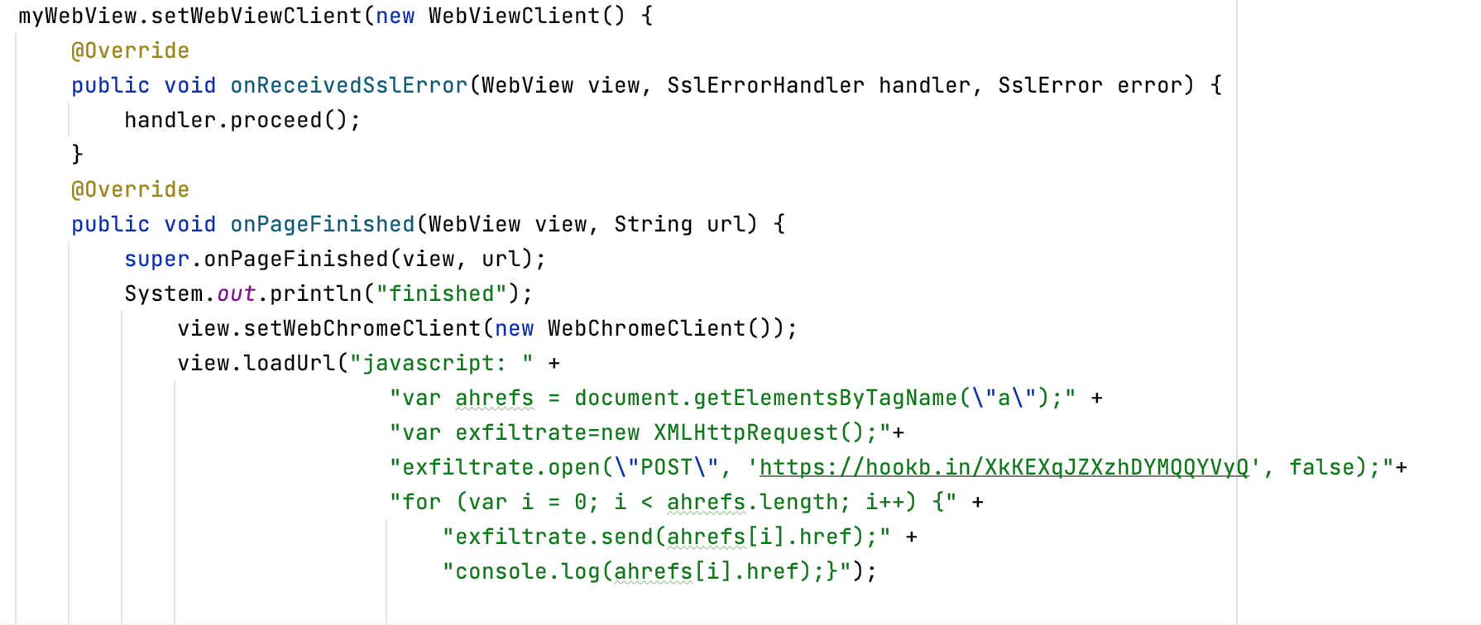
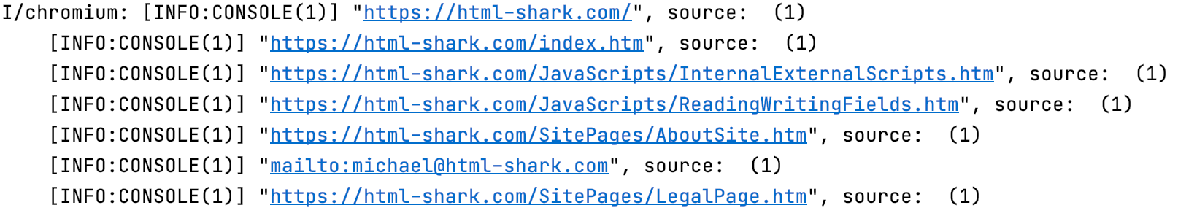
WebView - Javascript Injection - Scrapping

Slide 14
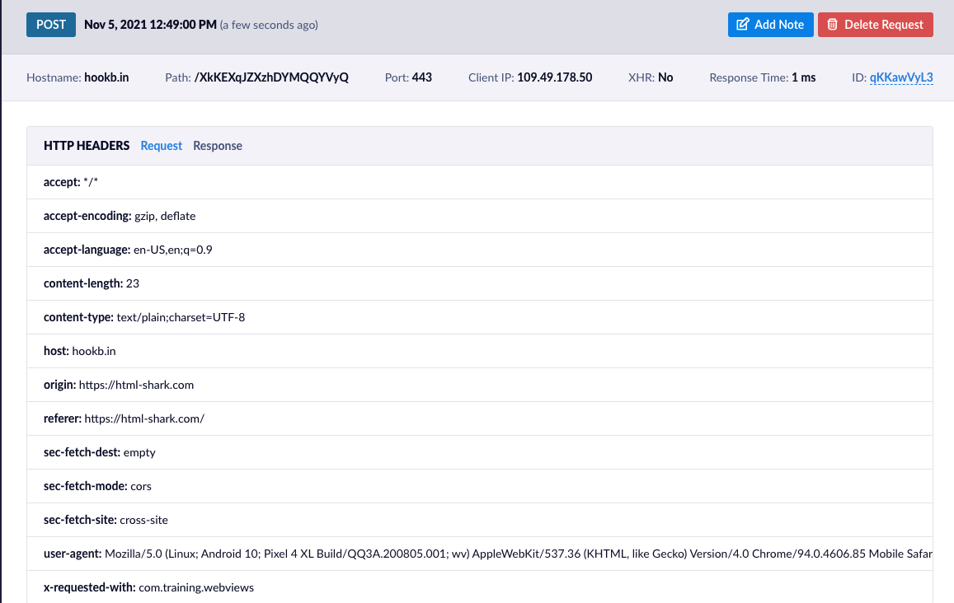
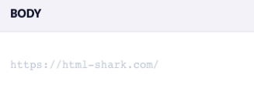
WebView - Javascript Scraping

Slide 15
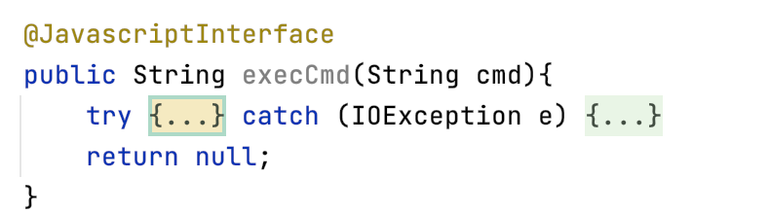
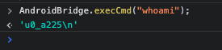
WebView - Backdooring

Slide 16

WebView - Silent Loading
By changing the visibility or the size of the webview all the operations can take place without being perceived by the user:
myWebView.setVisibility(myWebView.GONE)

Slide 17
Webviews - Malpractices
UnIntentional

Slide 18
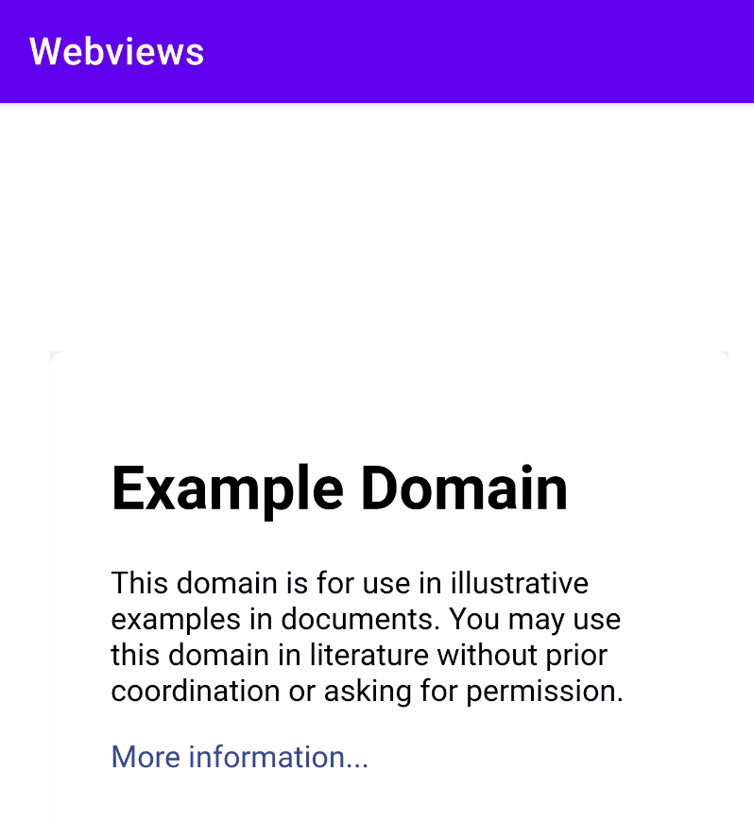
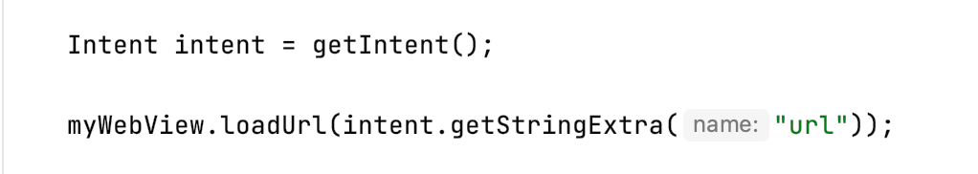
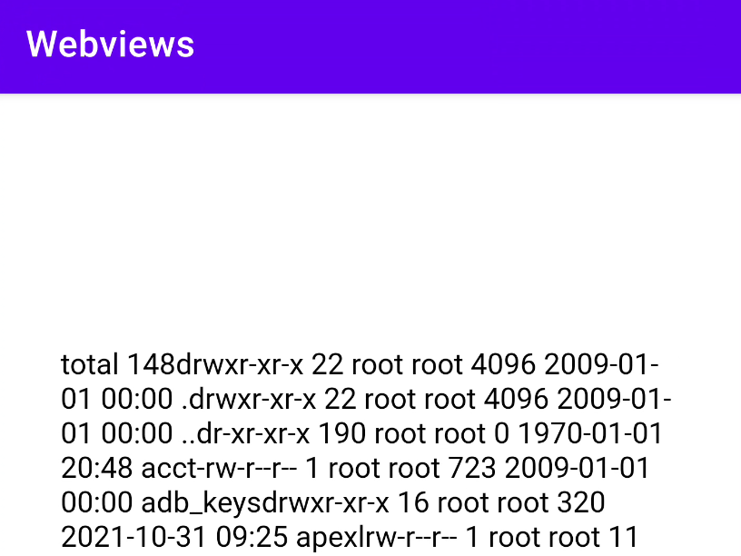
WebView - Hijacking
am start -n com.training.webviews/.MainActivity --es url https://www.example.com
am start -n com.training.webviews/.MainActivity --es url "javascript:AndroidBridge.execCmd('ls -al')"
Get the code https://github.com/Ch0pin/WebViews

Slide 19
Common Malpractices
Webviews
Floating Windows
Accessibility Service
Administration API
Reflection
Dynamic Code Loading

Slide 20
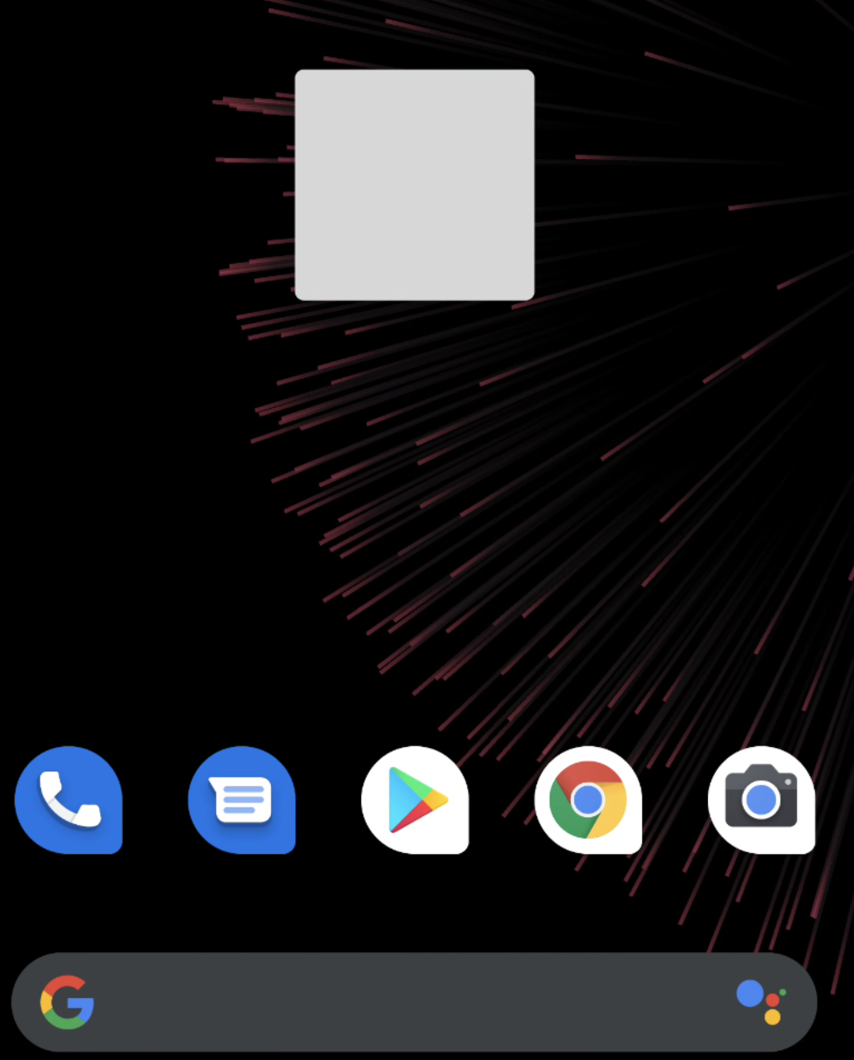
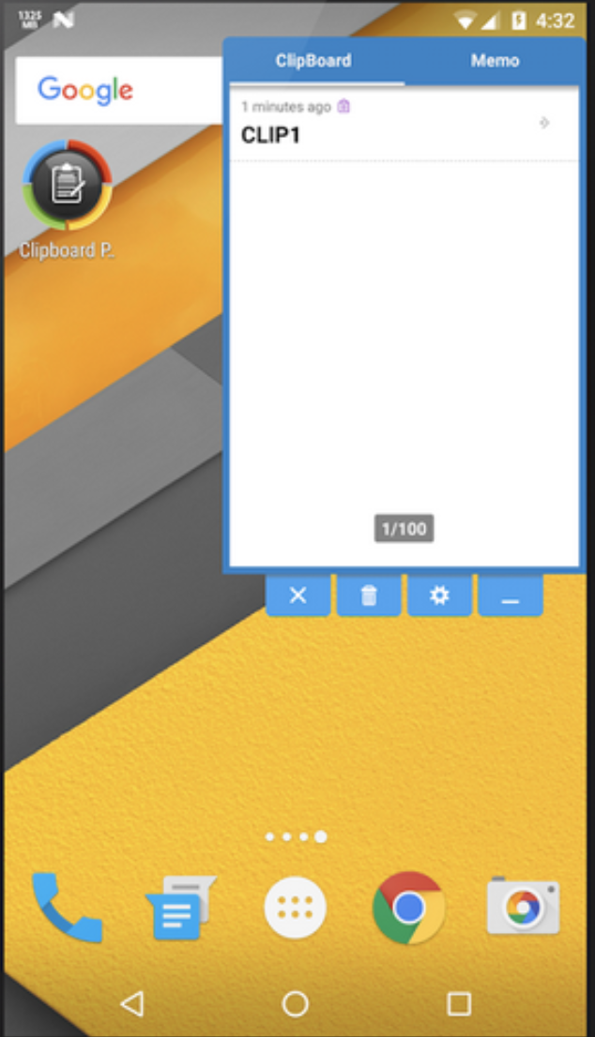
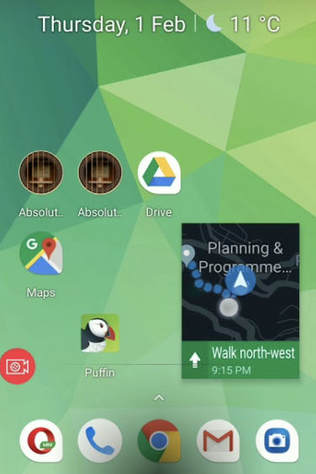
Free Floating Windows
Definition: A free floating window is a category of windows that can appear freely above any other applications while its existence doesn’t depend on its parent. Additionally, its behaviour and appearance is fully customisable and controllable by the developer.
Not to be confused with Picture in Picture (e.g. Google Maps, youtube e.t.c.)

Slide 21
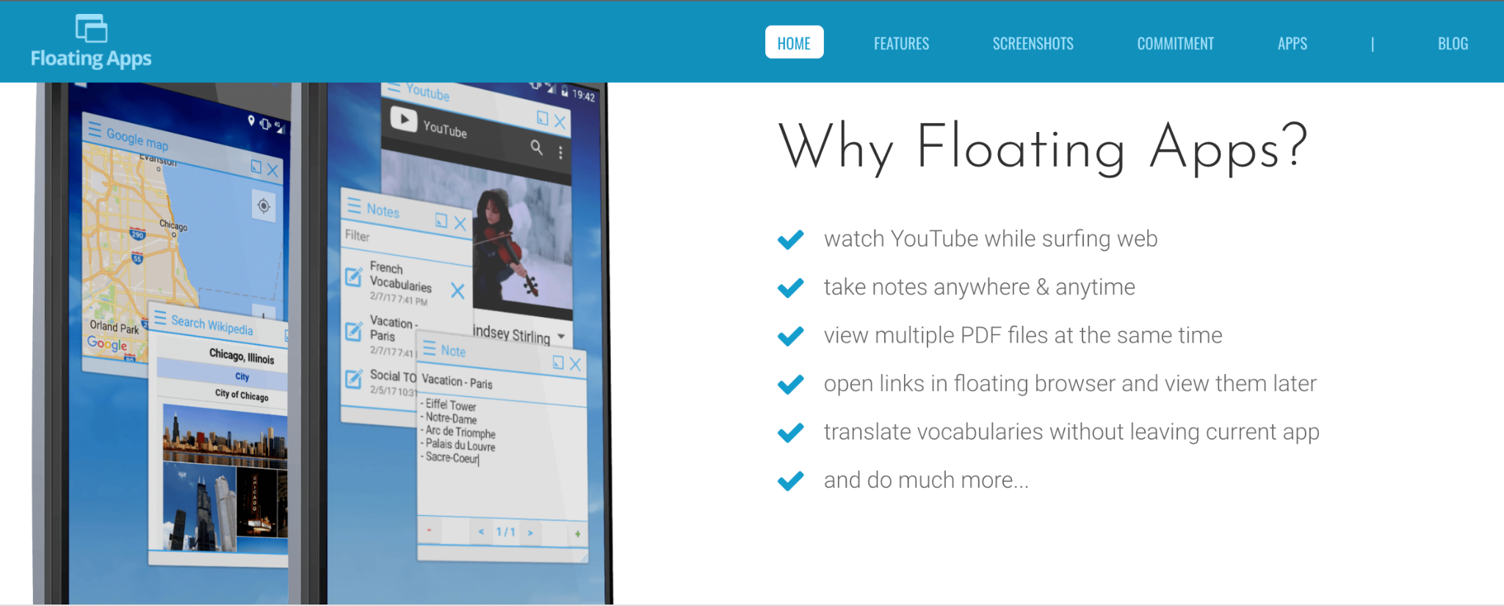
Free Floating Windows
Some Features
https://www.floatingapps.net/

Slide 22
FFW Implementation
By the time that SYSTEM_ALERT_WINDOW permission is approved, an application is authorised to create a TYPE_APPLICATION_OVERLAY window type which will be displayed on top of other activities, but below critical system ones (e.g. status bar or IME).
Besides a fully customizable appearance, a flag attribute will affect the event processing behaviour of a window, so a flag FLAG_NOT_TOUCHABLE will dispatch the events to the window behind, while a FLAG_WATCH_OUTSIDE_TOUCH will inform the app about the event but will omit details like the touch coordinates.

Slide 23
FFW Implementation (creating a floating button)
<uses-permission android:name="android.permission.SYSTEM_ALERT_WINDOW"/>
Create a view (e.g. a button)
Button floatingButton = new Button(getApplicationContext());
Create a Window Manager instance
WindowManager windowManager = (WindowManager) getSystemService(WINDOW_SERVICE);
Customize via the Layout Parameters
WindowManager.LayoutParams params = new WindowManager.LayoutParams(width, height,
WindowManager.LayoutParams.TYPE_APPLICATION_OVERLAY,
WindowManager.LayoutParams.FLAG_NOT_TOUCHABLE | WindowManager.LayoutParams.FLAG_NOT_FOCUSABLE,
PixelFormat.TRANSPARENT);

Slide 24

FFW Implementation (creating a floating button - continued )
Add the view to the FFW
windowManager.addView(floatingButton, params);
FFW

Slide 25

FFW Implementation (creating a floating button - continued )
Remove the Parent
<activity android:name=".MainActivity" android:autoRemoveFromRecents="true" android:noHistory="true">

Slide 26
FFW What is wrong with that ?
Background Restrictions (Android 8.0):
Apps that are running in the background now have limits on how freely they can access background services.
Apps cannot use their manifests to register for most implicit broadcasts (that is, broadcasts that are not targeted specifically at the app).
More restrictions ...
Android 10 (API level 29) and higher place restrictions on when apps can start activities when the app is running in the background. These restrictions help minimize interruptions for the user and keep the user more in control of what's shown on their screen.

Slide 27
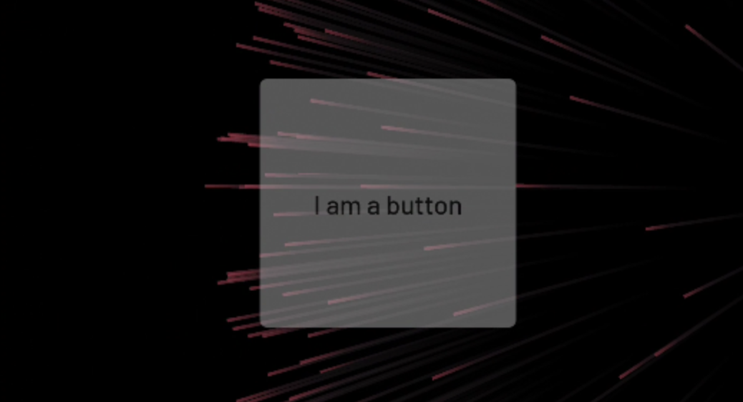


FFW What is wrong with that ?
Exceptions to the restriction
Apps running on Android 10 or higher can start activities only when one or more of the following conditions are met:
The app has a visible window, such as an activity in the foreground.
The app has an activity in the back stack of the foreground task.
The app has an activity in the back stack of an existing task on the Recents screen.
btn.setAlpha(0);
Can it be invisible ?

Slide 28
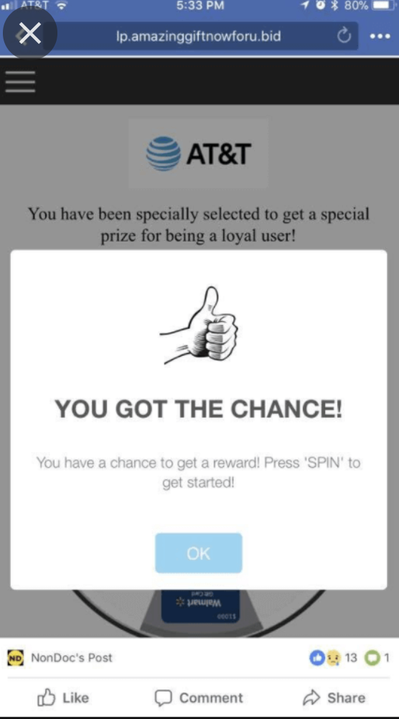
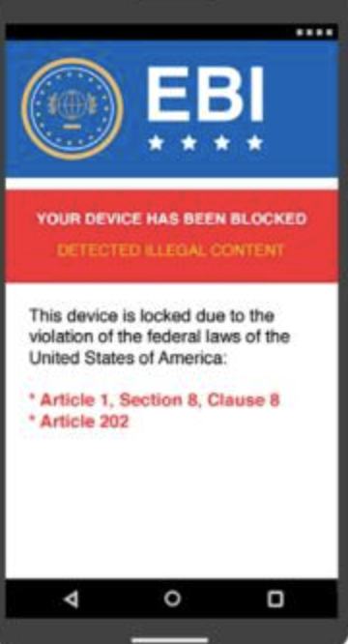
FFW Abuse
From Free Floating Windows to Free Popping Windows
SPAM
Ransomware

Slide 29
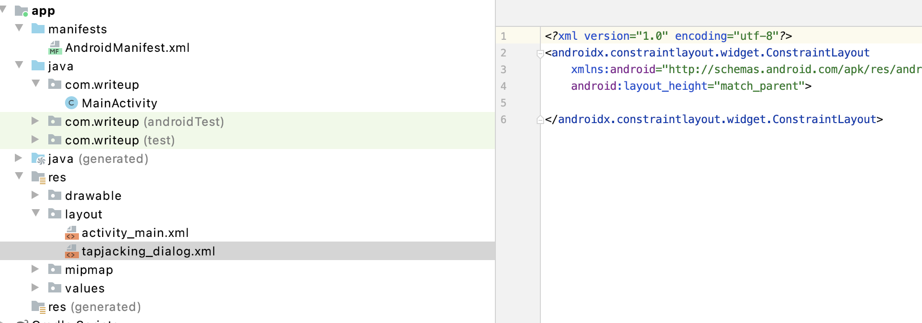
FFW Abuse, TapJacking
Creating more than a simple View...
A LayoutInflater instantiates a layout XML file into its corresponding View objects
LayoutInflater layoutInflater = getLayoutInflater();
View mLayout = layoutInflater.inflate(R.layout.tapjacking_dialog,null);
windowManager.addView(mLayout,params);

Slide 30
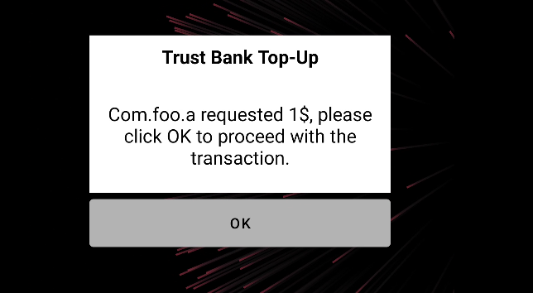
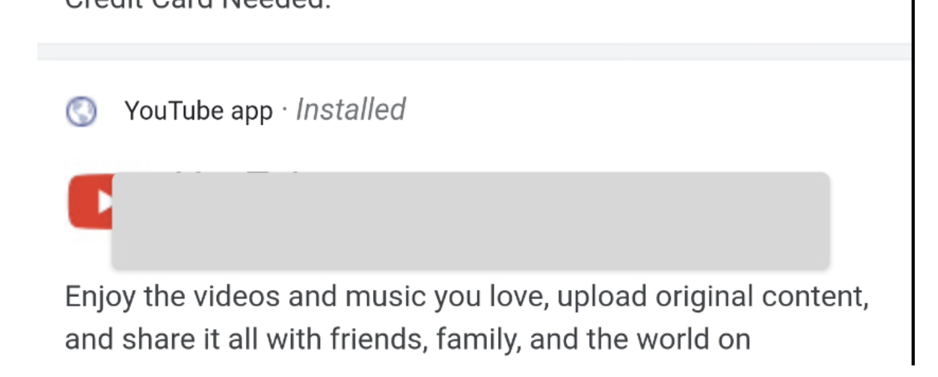
FFW Abuse, TapJacking
WindowManager windowManager = (WindowManager) getSystemService(WINDOW_SERVICE);
WindowManager.LayoutParams params = new WindowManager.LayoutParams(1200,1200,
WindowManager.LayoutParams.TYPE_APPLICATION_OVERLAY,
WindowManager.LayoutParams.FLAG_NOT_TOUCHABLE | WindowManager.LayoutParams.FLAG_NOT_FOCUSABLE,
PixelFormat.TRANSPARENT);
Click through:
Send touches to the window behind

Slide 31
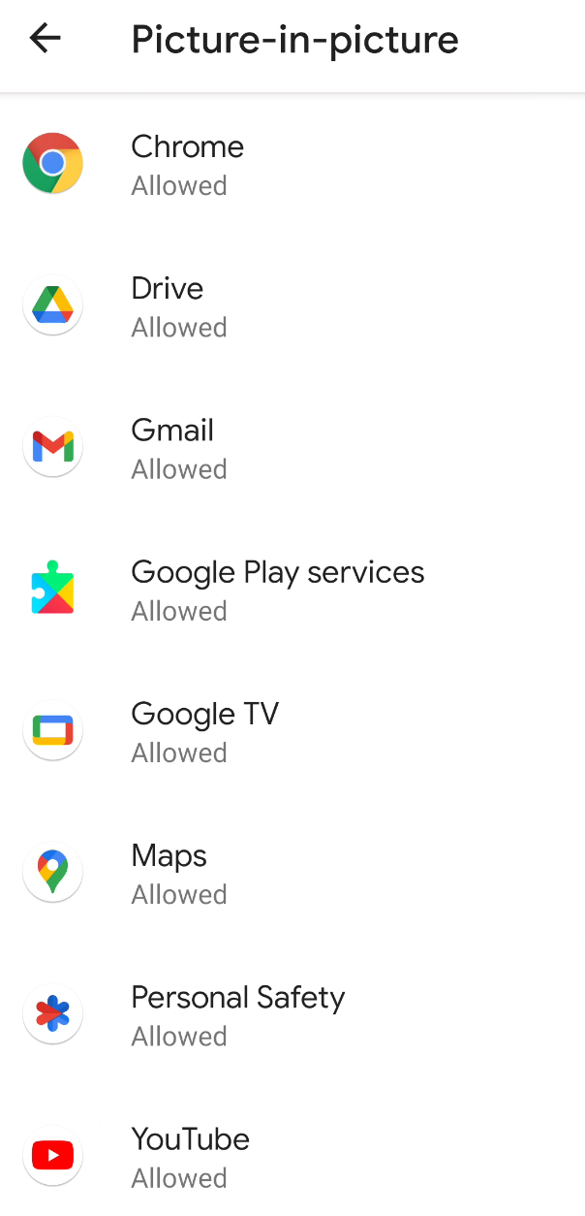
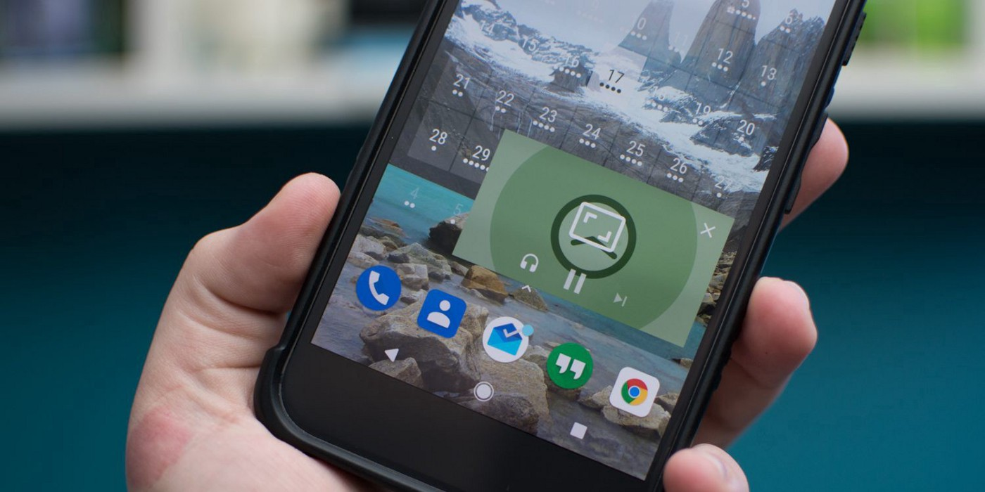
Picture In Picture
Definition: PiP is a special type of multi-window mode mostly used for video playback. It lets the user watch a video in a small window pinned to a corner of the screen while navigating between apps or browsing content on the main screen.
Popular Applications that use PiP:

Slide 32
Picture In Picture - Implementation
No special permissions !!
Add the specific entry in the AndroidManifest
<activity android:name="VideoActivity"
android:supportsPictureInPicture="true"
android:configChanges=
"screenSize|smallestScreenSize|screenLayout|orientation"
Call the enterPictureInPictureMode
public void onActionClicked(Action action) {
if (action.getId() == R.id.lb_control_picture_in_picture) {
getActivity().enterPictureInPictureMode();
return;
}
...
}

Slide 33
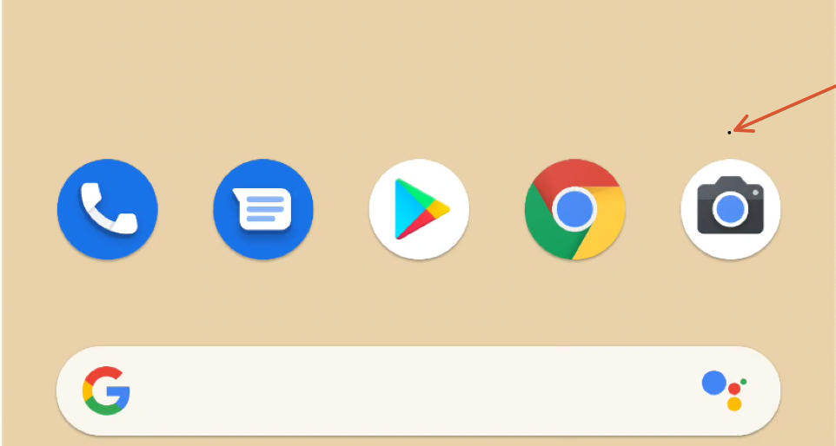
Picture In Picture
Applications in PiP mode maintain their foreground state
A PiP window is enclosed in a shadowed frame, which is a fact that renders it visible to the user even if the activity has been set up to be transparent.
No size restrictions though as it can be arbitrary small or large
<activity android:name=".MainActivity"
android:supportsPictureInPicture="true"
android:theme="@style/Theme.AppCompat">
<layout android:defaultHeight="1dp"
android:defaultWidth="1dp"
android:gravity="top|end"
android:minHeight="1dp"
android:minWidth="1dp" />

Slide 34
Common Malpractices
Webviews
Floating Windows
Accessibility Service
Administration API
Reflection
Dynamic Code Loading

Slide 35
Accessibility Service
The accessibility service provides user interface enhancements to assist users with disabilities, or who may temporarily be unable to fully interact with a device. For example, users who are driving, taking care of a young child might need additional or alternative interface feedback.
A powerful set of API calls, used by many popular apps including Google Assistant, Google maps, password managers, app lockers
but also from ….
Trojans, backdoors, bots, phishing apps e.t.c.
? ?

Slide 36
Accessibility Service from a security perspective
An application for which the accessibility service has been granted can run in the background and…
Read the UI of any other application
Parse the entire Android UI to check which layouts are in the screen
Check whether the screen has changed or the screen content has changed
Read notifications coming from/for any application
Perform Clicks / Swipes
Set text to textviews
… Pretty much, it can act in behalf of the user

Slide 37
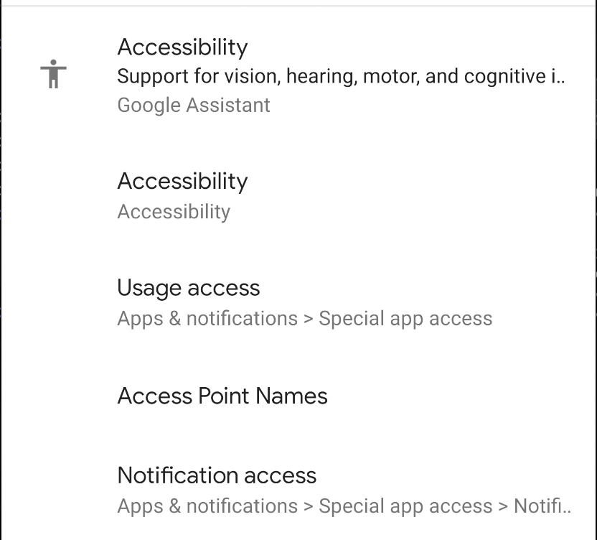
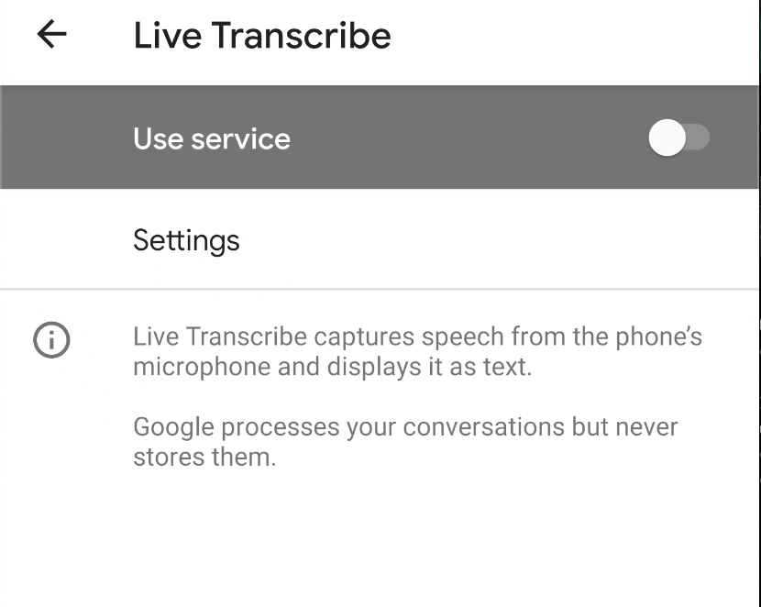
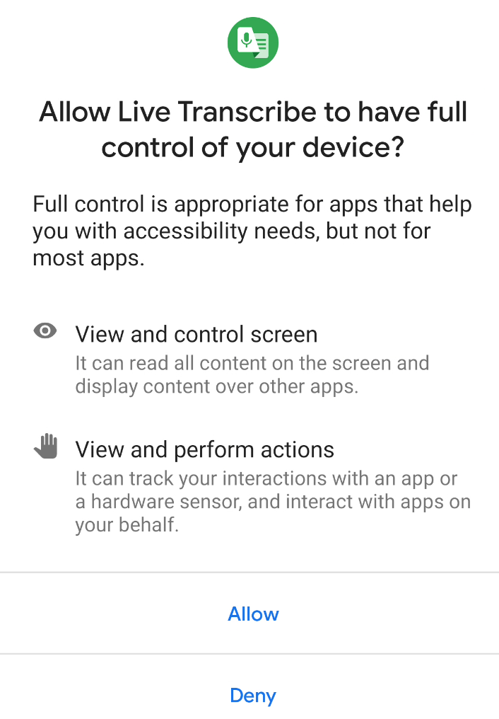
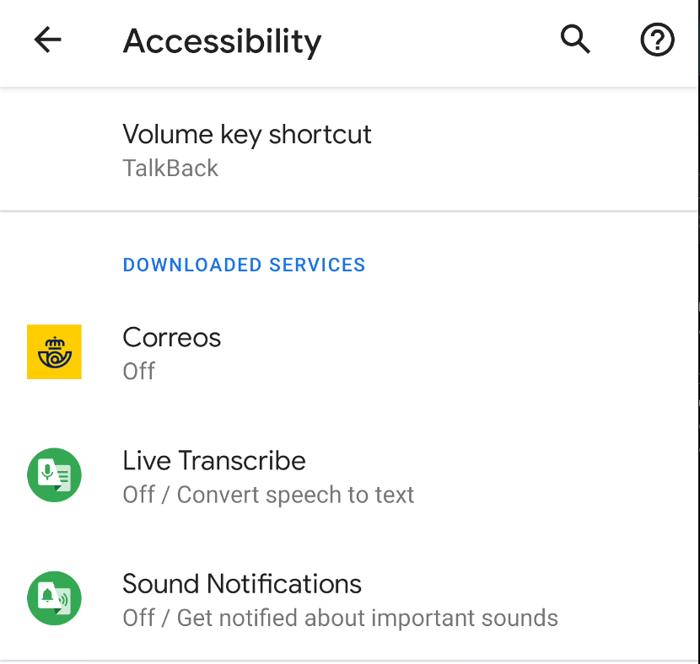
Accessibility Service - How to enable (Android 10)
Settings → Accessibility →
Click on the app →
Use Service→ Allow

Slide 38
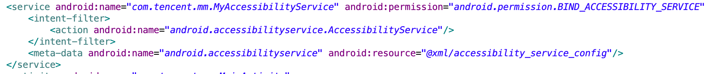
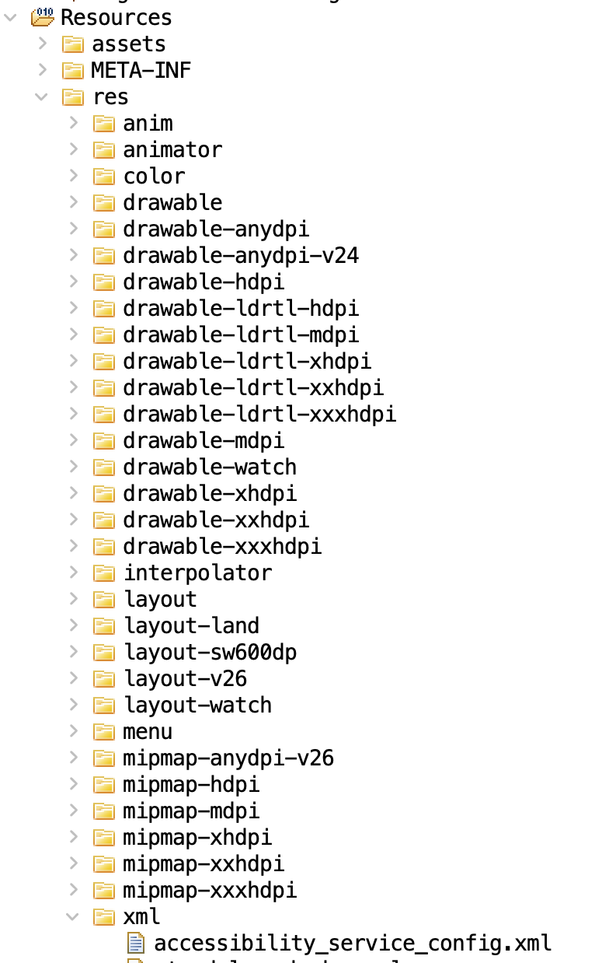
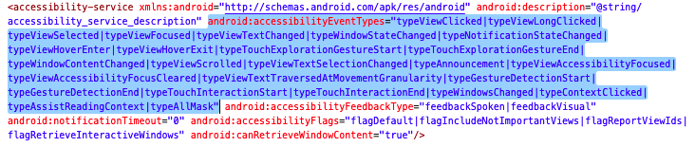
Accessibility Service - Implementation
Implementation Class
Permission
Intent filter
Configuration
AccessibilityService_accessibilityEventTypes: The event types this service would like to receive as specified in AccessibilityEvent. This setting can be changed at runtime by calling

Slide 39
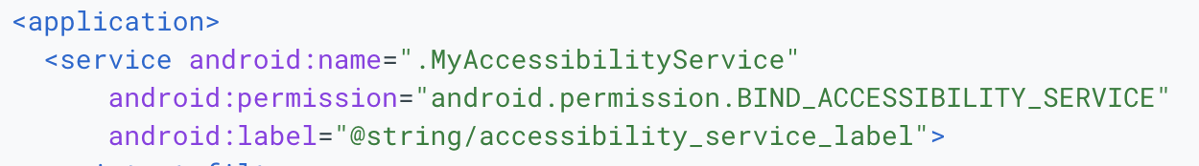
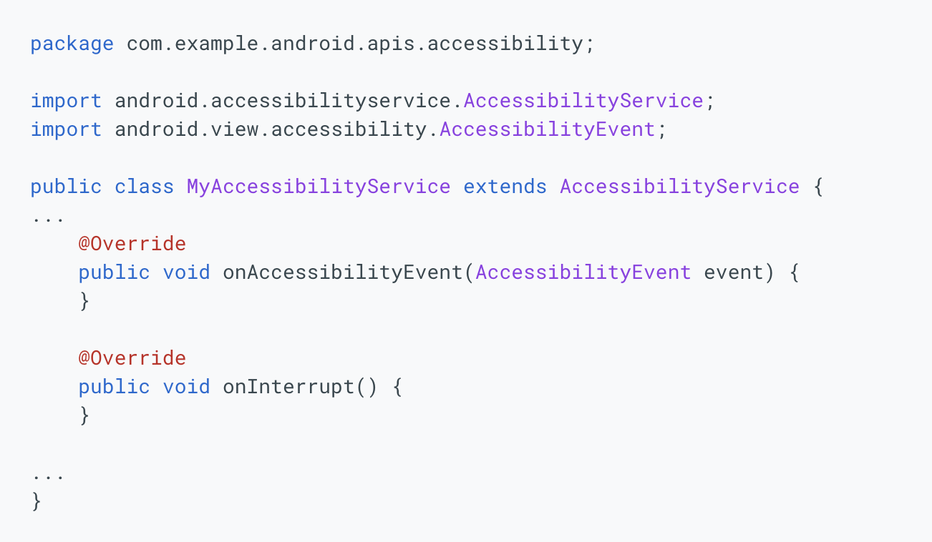
Accessibility Service - Java Code Implementation
Class name declared in the Manifest
Override Required

Slide 40
Accessibility Service - Accessibility Event
An accessibility event is fired by an individual view which populates the event with data for its state and requests from its parent to send the event to interested parties. The parent can optionally modify or even block the event based on its broader understanding of the user interface's context.
The main purpose of an accessibility event is to communicate changes in the UI to an AccessibilityService.
The service may inspect, if needed the user interface by examining the View hierarchy, as represented by a tree of AccessibilityNodeInfo (snapshot of a View state) which can be used for exploring the window content.

Slide 41
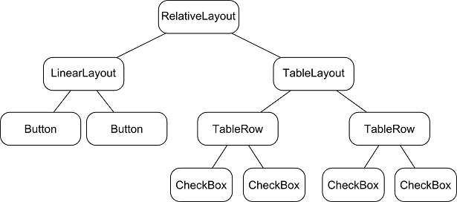
Accessibility Service - View Hierarchy Example
Figure by: https://stackoverflow.com/questions/18004148/android-what-is-view-hierarchy

Slide 42
Accessibility Service - Event Lifecycle
UI changed
Accessibility Event
No
Yes
Trigger Callback
Ignore
Match ?

Slide 43
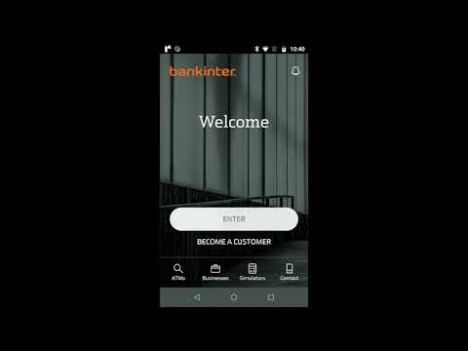
Accessibility Service - Abuse
Flutbot Abuses the accessibility service to get the foreground app.
If the application is in its target list, it will trigger an overlay which will cover the legitimate application with a fake one
After getting the credentials inserted to the fake view, it sends them to a Command and Control server
Video by: https://www.threatmark.com/flubot-banking-malware/

Slide 44
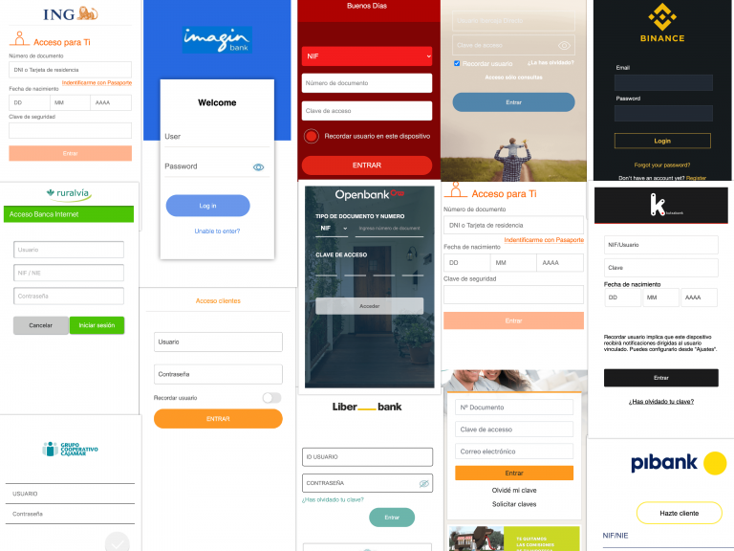
Accessibility Service - Abuse
Overlays targeting legitimate applications
Figure by: https://www.threatmark.com/flubot-banking-malware/

Slide 45

Accessibility Service - Abuse, Overlays
Monitoring the API calls performed by the accessibility service implementation.

Slide 46
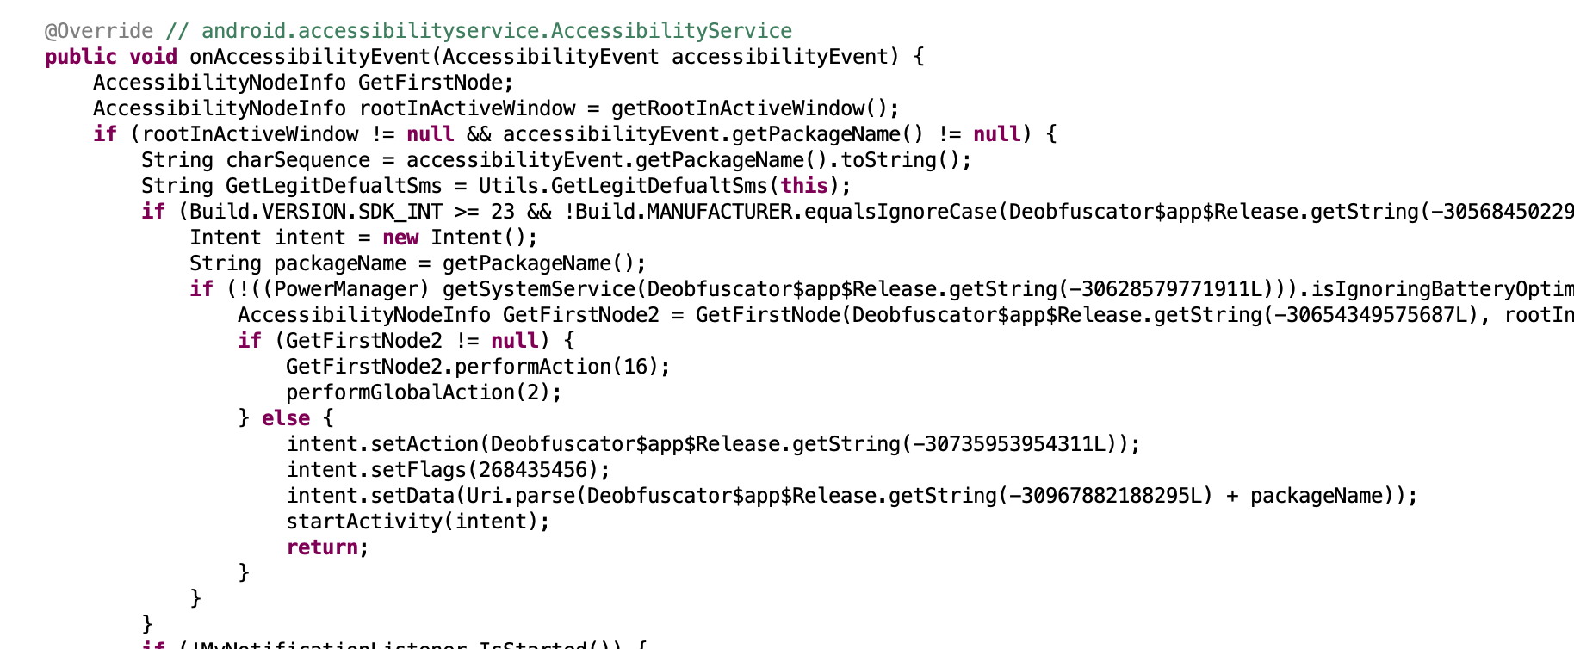

Accessibility Service - Abuse
Click
Home

Slide 47
Accessibility Service - Abuse
log typed keys (keyloggers)
auto-enable permissions
auto-enable access to services
When correctly coordinated it can perform chain of actions to automate more complex tasks (e.g. screen recording)

Slide 48
Common Malpractices
Webviews
Floating Windows
Accessibility Service
Administration API
Reflection
Dynamic Code Loading

Slide 49

Device Admin
Definition: The Device Administration API provides device administration features at the system level. These APIs allow you to create security-aware apps that are useful in enterprise settings, in which IT professionals require rich control over employee devices.

Slide 50
Device Admin
Set password quality.
Specify requirements for the user's password, such as minimum length, the minimum number of numeric characters it must contain, and so on.
Set the password. If the password does not conform to the specified policies, the system returns an error.
Set how many failed password attempts can occur before the device is wiped (that is, restored to factory settings).
Set how long from now the password will expire.
Set the password history length (length refers to number of old passwords stored in the history). This prevents users from reusing one of the last n passwords they previously used.
Specify that the storage area should be encrypted, if the device supports it.
Set the maximum amount of inactive time that can elapse before the device locks.
Make the device lock immediately.
Wipe the device's data (that is, restore factory settings).
Disable the camera.

Slide 51

Device Admin - Implementation
DeviceAdminReceiver subclass
Permission
Filter

Slide 52

Device Admin - Callbacks
Permission

Slide 53
Common Malpractices
Webviews
Floating Windows
Accessibility Service
Administration API
Reflection
Dynamic Code Loading

Slide 54


Java Reflection
Reflection is commonly used by programs which require the ability to examine or modify the runtime behavior of applications running in the Java virtual machine. This is a relatively advanced feature and should be used only by developers who have a strong grasp of the fundamentals of the language. With that caveat in mind, reflection is a powerful technique and can enable applications to perform operations which would otherwise be impossible.
Figure from: https://techvidvan.com/tutorials/reflection-in-java/

Slide 55

Java Reflection
url: https://techvidvan.com/tutorials/reflection-in-java/

Slide 56


Java Reflection
The Test class users reflection to get the ReflectionDemo class characteristics and invoke its defined methods.
https://techvidvan.com/tutorials/reflection-in-java/

Slide 57

Java Reflection - Misuse
Can be used to “hide” suspicious API calls
Example: “java.lang.Runtime” , “1”
Return
[PGP.]P_V.cD_EX\T
Class cls = Class.forName(decrypt(“[PGP.]P_V.cD_EX\T”));

Slide 58
Common Malpractices
Webviews
Floating Windows
Accessibility Service
Administration API
Reflection
Dynamic Code Loading

Slide 59

Dynamic Code Loading - DCL
DCL(Dynamic code loading) allows an application to load code that is not part of its static, initial codebase. The additional code can be retrieved from a remote location and executed at runtime.
Code Reuse
Extensibility
Self-upgrade

Slide 60
Dynamic Code Loading - Implementation
DexClassLoader(String dexPath, String optimizedDirectory, String librarySearchPath, ClassLoader parent)
dexPath | String: the list of jar/apk files containing classes and resources, delimited by File.pathSeparator, which defaults to ":" on Android
optimizedDirectory | String: this parameter is deprecated and has no effect since API level 26.
librarySearchPath | String: the list of directories containing native libraries, delimited by File.pathSeparator; may be null
parent | ClassLoader: the parent class loader

Slide 61
Dynamic Code Loading - Implementation
Fetch the dex, jar, apk e.t.c
DexClassLoader(String dexPath, String optimizedDirectory, String librarySearchPath, ClassLoader parent)
String dexPath = context.getFilesDir().getAbsolutePath() + “/” +"dexPath.dex";
Final DexClassLoader nClazz = new DexClassLoader(dexPath,mContext.getCodeCacheDir().getAbsolutePath(), null,getClass().getClassLoader()).loadClass(clazz);

Slide 62

Dynamic Code Loading - what is wrong with this ?
https://www.fortinet.com/blog/threat-research/unmasking-android-malware-a-deep-dive-into-a-new-rootnik-variant-part-ii

Slide 63


Dynamic Code Loading - what is wrong with this ?
Name can be encrypted
Content can be encrypted
https://www.fortinet.com/blog/threat-research/unmasking-android-malware-a-deep-dive-into-a-new-rootnik-variant-part-ii

Slide 64
References
https://ink.library.smu.edu.sg/cgi/viewcontent.cgi?article=4724&context=sis_research
https://valsamaras.medium.com/tapjacking-attacks-a-thorough-guide-2cd6486d0fc9
https://developer.android.com/guide/topics/ui/picture-in-picture#:~:text=PiP%20is%20a%20special%20type,content%20on%20the%20main%20screen
https://www.tutorialspoint.com/android/android_user_interface_layouts.htm
https://www.zdnet.com/article/this-new-malware-uses-remote-overlay-attacks-to-hijack-your-bank-account/
https://developer.android.com/reference/android/webkit/WebView
https://developer.android.com/guide/topics/ui/accessibility/service
https://www.javatpoint.com/java-reflection
https://kalpeshchandora12.medium.com/dynamic-code-loading-in-android-dea83ba3bc85

